Slide 1
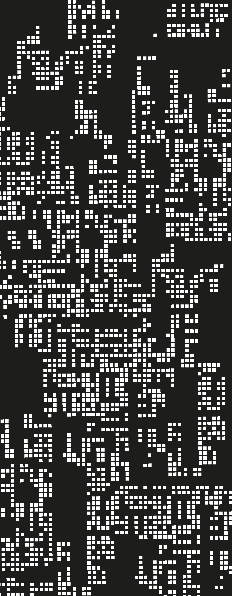
Basics
2. Functions and Recursion

Slide 2
Contents
01
Functions as values
02
Methodology
03
Recursion + Induction
04
Pattern Matching

Slide 3
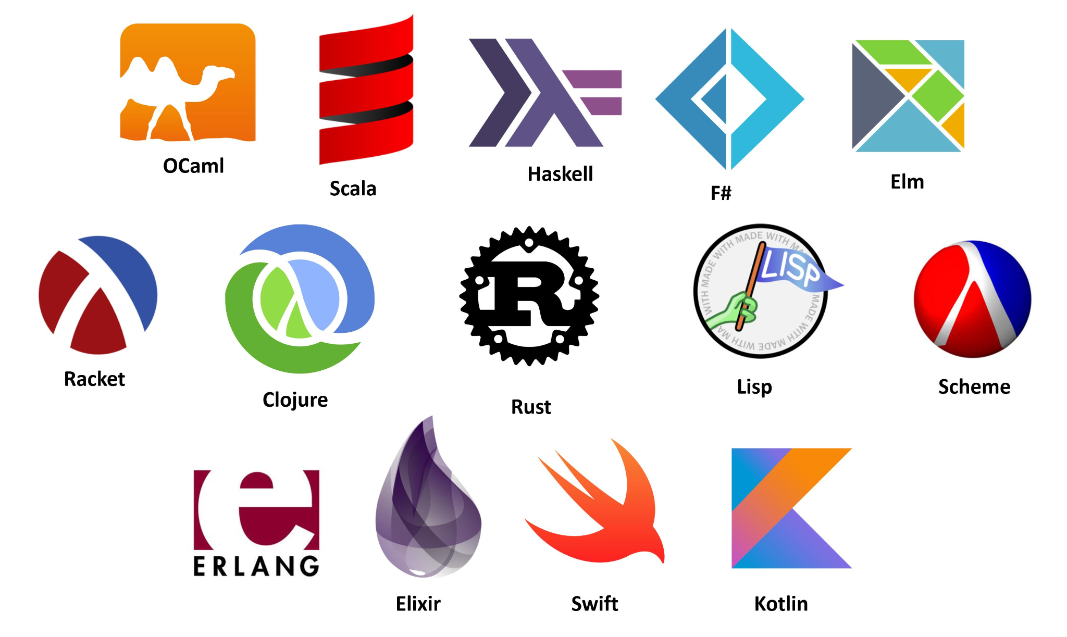
What are functions in Scheme?
Execute any function you’ve learned without the parentheses. e.g.
+
What is the result?
Does it report an error?
No, but in languages as C or Java, it would be an error. In those languages, the functions are NOT values. However in many languages, functions ARE VALUES. This is a powerful feature

Slide 4
Functions as parameters
What is it useful for?
ABSTRACTION, let’s think on the following problem, tell the logic of the solution
With an array [“earth”, “mars”, “neptune”, “jupiter”] as parameter, return an array with the character count of each word: [5,4,7,7].

Slide 5
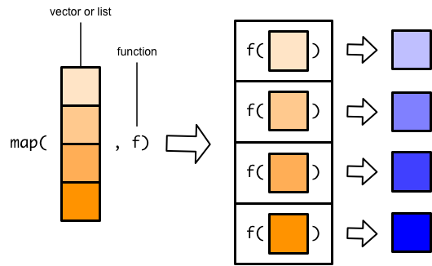


Map
From: 9 Functionals | Advanced R and 9 Basic map functions

Slide 6
Functions as parameters
What is it useful for?
ABSTRACTION, let’s think on the following problem, tell the logic of the solution
Parting of a list [1,2,3,4,5] obtain the summation of all the values.

Slide 7
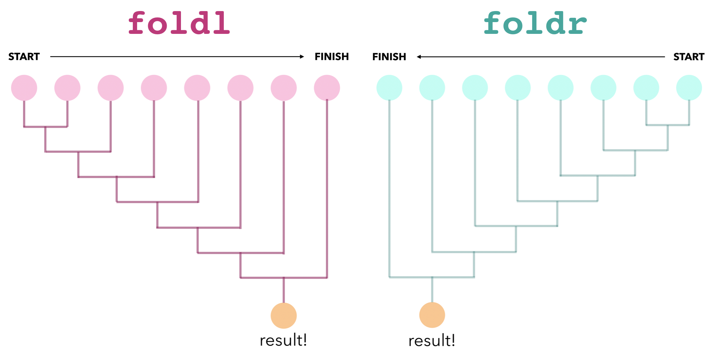
Fold l/r (reduce)
From: Drawing foldl and foldr – Blog – Joachim Breitner's Homepage

Slide 8
Other functions - Homework
With the list ‘(1 2 3 4 5) execute the following expressions and say, why do we obtain this result?
(foldl cons '() my-list)
(foldr cons '() my-list)
Define, using foldl a function (reject lst pred) which returns the list of the elements of lst that do not satisfy the condition pred.
Write one example of functions that allow filtering and searching
Use of the previous seen in the real world → MapReduce: Simplified Data Processing on Large Clusters – Google Research

Slide 9
Anonymous Functions
Sometimes, we may need functions that are not crucially used by different methods and that execute some expressions. There, we may use a function with no name.
When a function receives another one as argument, is called higher order function

Slide 10
Functions that return functions
So, with anonymous functions we can do something awfully powerful, define functions that create functions.
Define function (curry f) that given a function (A B → C) returns an equivalent function A → (B → C).
> (define cons1 ((curry cons) 1))
> (map cons1 '(a b c d))
'((1 . a) (1 . b) (1 . c) (1 . d))

Slide 11
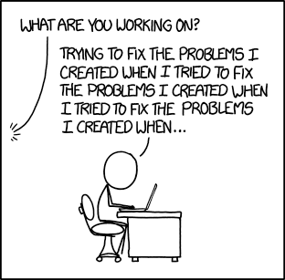
Methodology for function writing
So, functions are powerful, how we should write them?
Understand what is the use of the function.
Write the contract (parameters + types, return type).
Write the description of the function in a small comment.
Write meaningful unit tests before anything else.
Implement the function body.

Slide 12
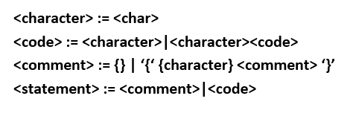
Backus-Naur Form → BNF

Slide 13
How to process recursive structures?
Induction → To establish properties.
So to demonstrate that P(n) is valid for any n (where n is a natural number). You need to prove that:
P(0) : P is applicable for 0 (or base case, which may vary)
P(n) ⇒ P(n+1) : If P is applicable for n, it should be applicable for the next n+1.

Slide 14
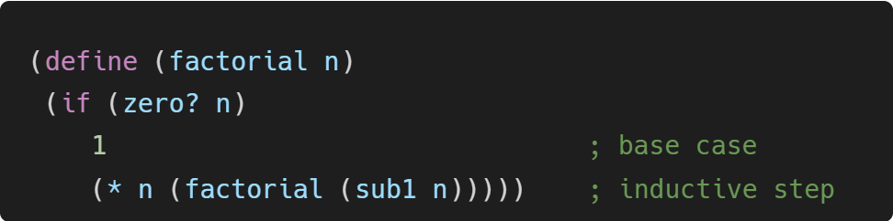
Induction + Recursion
induction (mathematical logic) ~= recursion (programming)
(Curry-Howard correspondence)

Slide 15
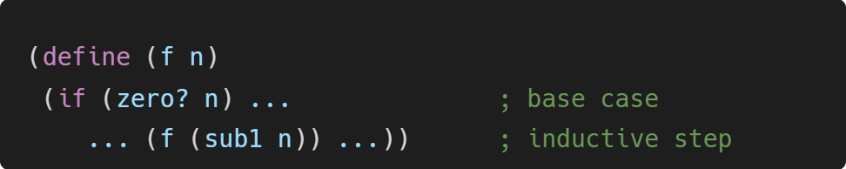
Induction + Recursion
induction (mathematical logic) ~= recursion (programming)
(Curry-Howard correspondence)

Slide 16
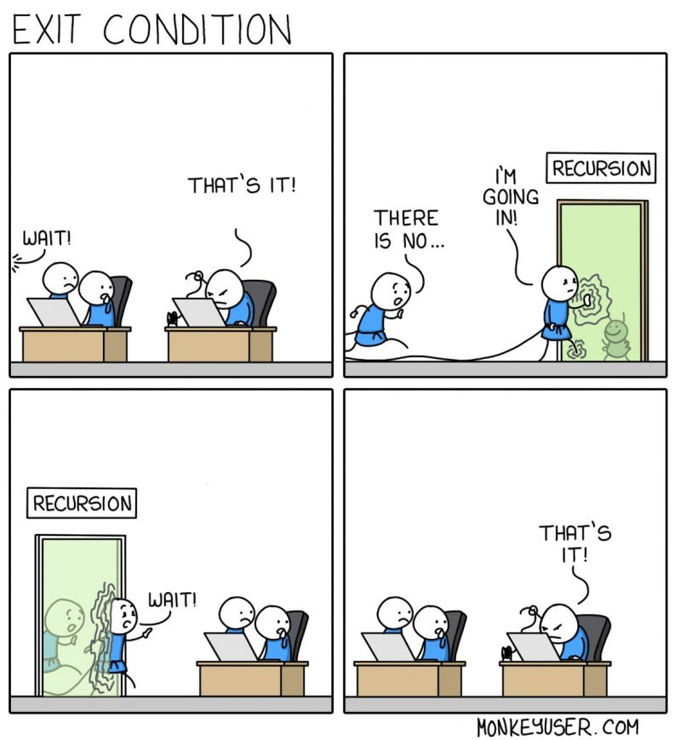
Induction + Recursion
This generalization is called STRUCTURAL INDUCTION. So the methodology we saw earlier is completed by splitting the last step into two:
Understanding the process, write the recursive pattern.
Complete the body function, analyzing the cases

Slide 17
Pattern Matching
So, to work with data structures, we need to identify patterns.
To do so, we consider every constructor of the data structure as a case.
But matching in Racket is wider, for lists, pairs, vectors, tons of things

Slide 18
Summary
Functions are values (as arguments or return values). This is powerful.
Use the methodology, do not rush on implementing, that is the last step.
Follow the grammar, search for patterns.

Slide 19
On next class
Parsing
Expressions
Our first little language

Slide 20
References
PrePLAI, sections 3 and 4.
Racket Guide
Racket Reference

